Slide 1
FIRST AND FOLLOW

Slide 2
Rules for FIRST SET
If α is a terminal ‘a’ then First(α) is {a}.
- Eg. If A->a, then First(A) = {a}.
If α is a non terminal ‘X’ & X->A & A->a, then First(X) = {a}.
If α is a non terminal ‘X’, & X-> ε, then First(X) = {ε}.
- Eg. If A-> ε, then First(A)-> ε.
If X -> Y1,Y2,Y3,…,Yk then First(X) = First(Y1). If First(Y1) has ε then X has First(Y2) and so on.
Note – First sets can contain ‘ε’.

Slide 3
Rules for FOLLOW SET
1. Whenever you want to find follow of a symbol, find the symbol in R.H.S.
2. If symbol is start symbol, add $ to follow set.
3. If symbol is followed by a terminal, straightway add the terminal to the follow set.
4. If the symbol is followed by non-terminal, find the first of the non-terminal.
4.1 – If the first set contains ε, exclude ε from follow sets & replace it in the production.
4.2 – If even after replacement by ε, it is followed by terminal or non terminal, repeat the process.
5. If the symbol is last one in the production, then add follow of head into follow set.
Note – Follow set do not contain ‘ε’

Slide 4
Points to remember while constructing Parse Table
Make a empty table in which rows are labelled with the non-terminals and columns with the terminals of the grammar.
$ is explicitly added in every parse table.
Never add Epsilon in the parse table.

Slide 5
Construction of Predictive Parse Table
Algorithm : Construction of a predictive parsing table
Input: Grammar G
Output: Parsing table M
Method:
For each production of the form A→ α of the grammar, do steps 2 and 3
For each terminal symbol ‘a’ in FIRST(α), add A→ α to M[A,a]
If ε is in FIRST(α ) add A→ α to M[A,b] for each terminal b in FOLLOW(A). If ε id in FIRST(α) and $ is in FOLLOW(A), add A→ α to M[A,$]
Make each undefined entry of M be error.

Slide 6
Steps needs to be followed for constructing a parse table and to parse a given input string.
Eliminate Left Recursion (if any) in the grammar G.
Perform left factoring on G.
Find FIRST and FOLLOW on the symbols in G.
Construct predictive parse table.
Check if the input string is accepted by parser using the parse table entries.

Slide 7
Non –Recursive Predictive Parsing
It is built maintaining a stack.
The table driven parser has an
Input buffer
Stack containing sequence of grammar symbols
Parsing tables
Output stream
Input buffer:
Has the string to be parsed.
End of the string is marked with a $.
Stack
$ marks the bottom of the stack.
Initially it has start symbol of the grammar on the top.

Slide 8
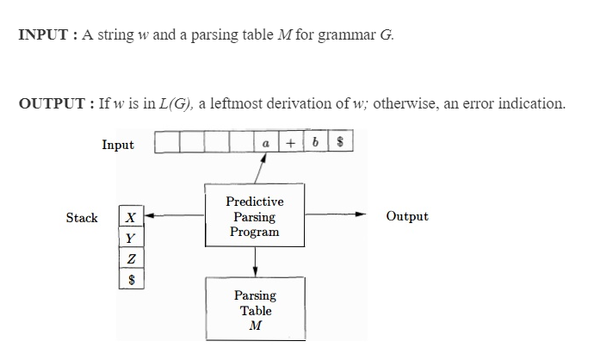
Table Driven Predictive parsing Algorithm

Slide 9
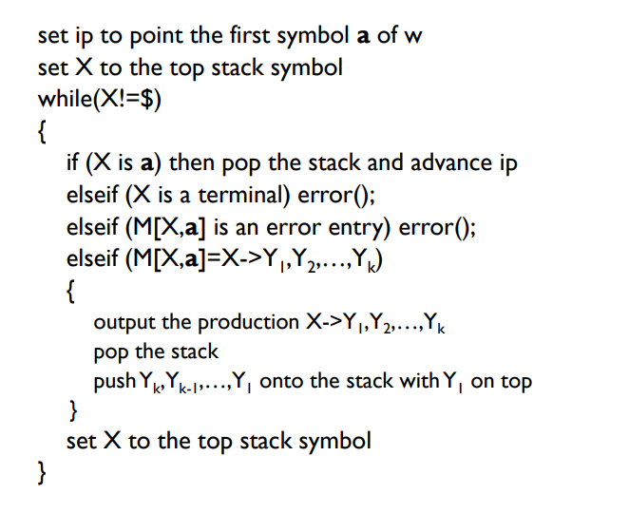
Predictive parsing Algorithm

